Slide 1
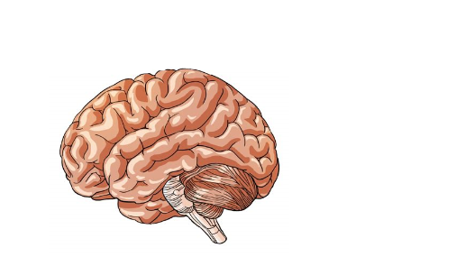
Autism
What is Autism?
When amazing things happen
Notes:
Autism is a neurodivergent condition which means the brain has developed in a slightly different way to a typical person’s development. This can affect how an autistic person experiences the world.
I thought we could start with a video animation called “When Amazing Things Happen” to help you understand how the world may appear different to an autistic person. [Play the video “When Amazing things happen” – the link is embedded in the slide in the name of the video, hopefully!]. https://www.youtube.com/watch?v=RbwRrVw-CRo

Slide 2
Four Aspects of Autism
Social Interaction
Communication
Imagination, rigidity and strong interests
Sensory difficulties
Notes:
No two autistic people are the same. There are 4 areas which autistic people can typically struggle with, however these struggles can differ in different proportions between different individuals. Even for one individual the extent of the difficulties in each area can vary throughout different stages of their life, or even at different times throughout the day. The autistic spectrum is therefore no longer viewed as a linear line but a bit like a pie chart [examples on next slide].

Slide 3
Another way to visualise the autistic spectrum
Highly-focused interests
Sensory sensitivity
Repetitive behaviour/routines
Social communication
Social interaction
A
Autism
Spectrum
B
C
Notes:
This is another way to visualise the Autistic Spectrum, with A, B and C representing either different people, or the same person at different times in their life, or at different times of the day depending on the environment they are in. The size of each triangle indicates the increased level of difficulty in that area. Not all autistic people will have difficulties in all areas.
Because all Autistic people present differently we say “When you’ve met one autistic person, you’ve met one autistic person.”

Slide 4
Highly Focused Interests
Intense and highly focused interests – often from a fairly young age
Can change over time or be lifelong
Can also become attached to objects – an interest is collecting is quite common
Strong interests can be fundamental to am autistic person’s wellbeing and happiness, they can:
Help manage the uncertainties of daily life as a strong interest can provide structure, order and predictability
Provide a way to start conversations and feel more confident in social situations
Help them relax and feel happy
Notes:
Autistic people often develop intense and highly focused interests, often from a fairly young age. They can change over time or be life long – when I was young I was obsessed with lifts, now I’m older I have a strong interest in cars and especially Tesla.
Autistic people can also get attached to objects and so an interest in collecting things is common.
Strong interests can be fundamental to an autistic person’s wellbeing and happiness, they help to manage the uncertainty of daily life, as a strong interest can provide structure, order and predictability; a way to start conversations to feel more confident in social situations; and to help them feel relaxed and happy.

Slide 5
Sensory Sensitivity
Daily difficulty processing sensory information
Can be hypersensitive – finds sensory stimuli overwhelming, or hyposensitive – experiencing little or no response to sensory stimuli
8 different senses not just 5!:
Hearing (Auditory)
Touch (Tactile)
Sight (Visual)
Taste (Gustatory/Oral)
Smell (Olfactory)
Balance (Vestibular)
Body Awareness (Proprioception)
Awareness of Internal Organs (Interoceptive)
Notes:
Autistic people can have difficulty with sensory stimuli in their day-to-day environment. Whilst a neurotypical person learns to filter out unwanted background stimuli, a neourodivergent autistic person may struggle in this area and become overwhelmed.
It is possible to be both hypersensitive and hyposensitive to sensory stimuli and did you know there are actually 8 senses not just 5!
Autistic people can have more difficulty with their vestibular sense of balance, Proprioception sense of the awareness of their body in space and their Interoceptive sense – awareness of their internal organs, for example they may struggle to identify whether they are too hot/too cold to choose weather appropriate clothing, or may not recognise when they are hungry or have eaten too much!

Slide 6
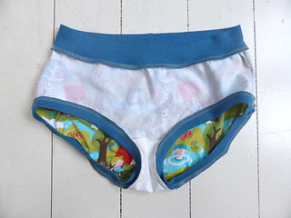
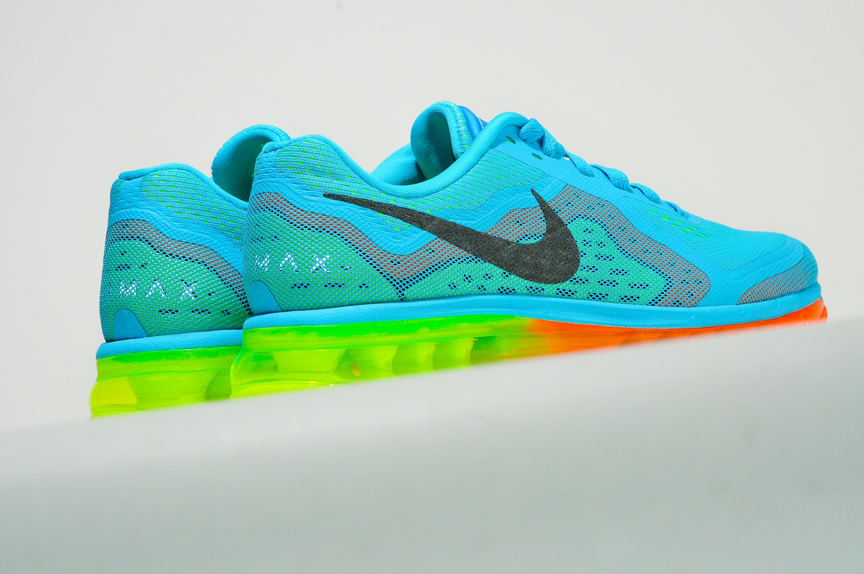
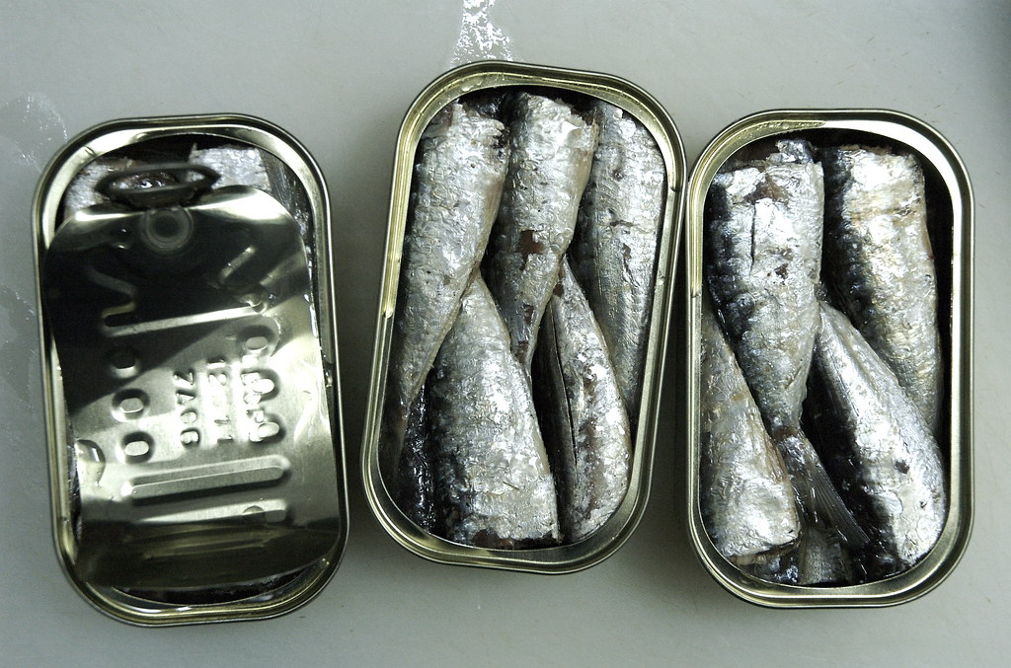
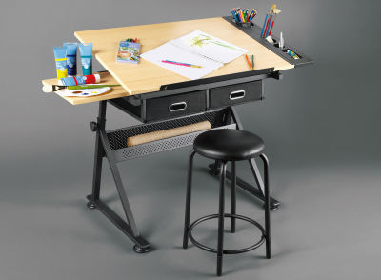
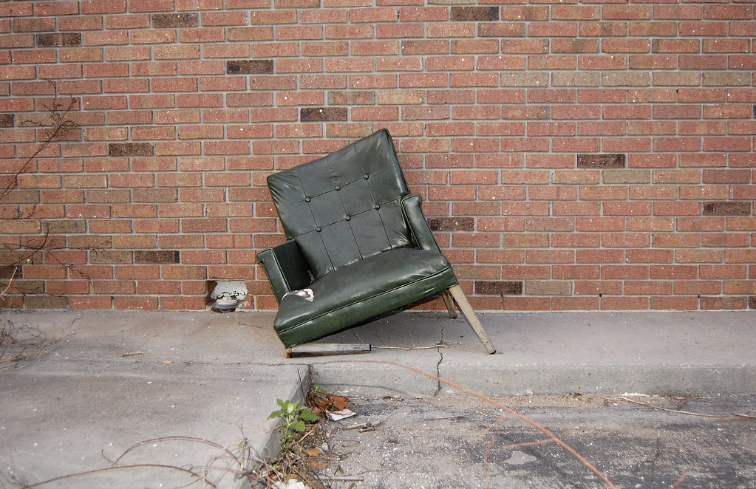
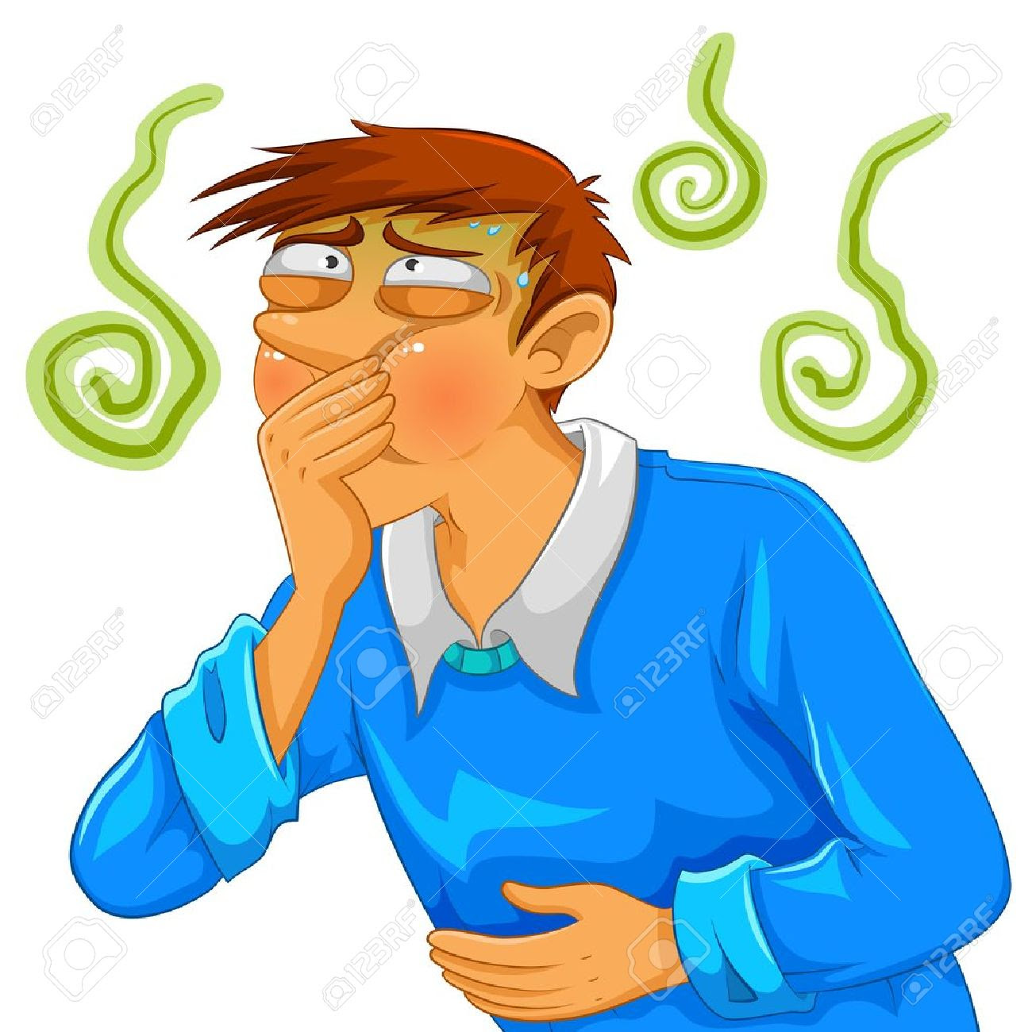
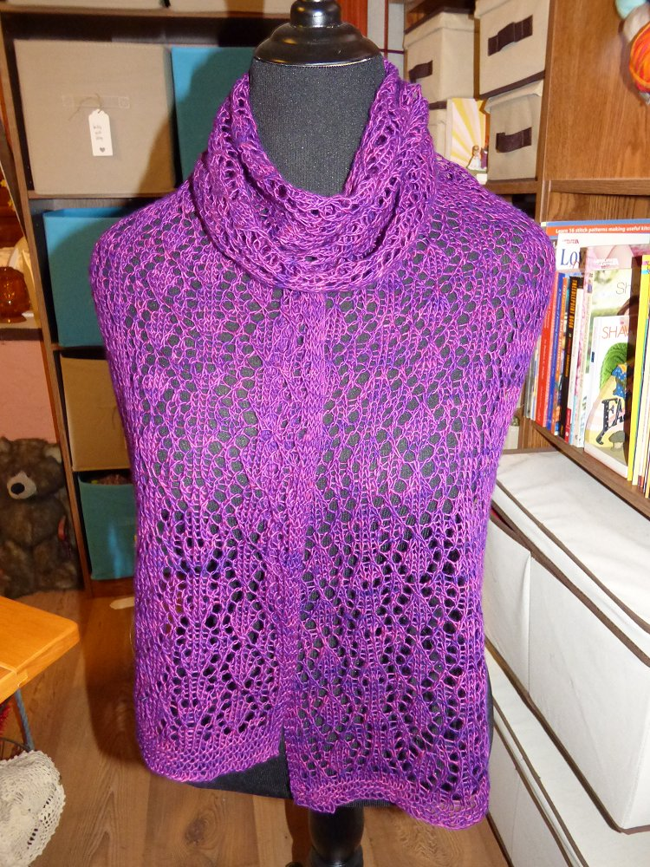
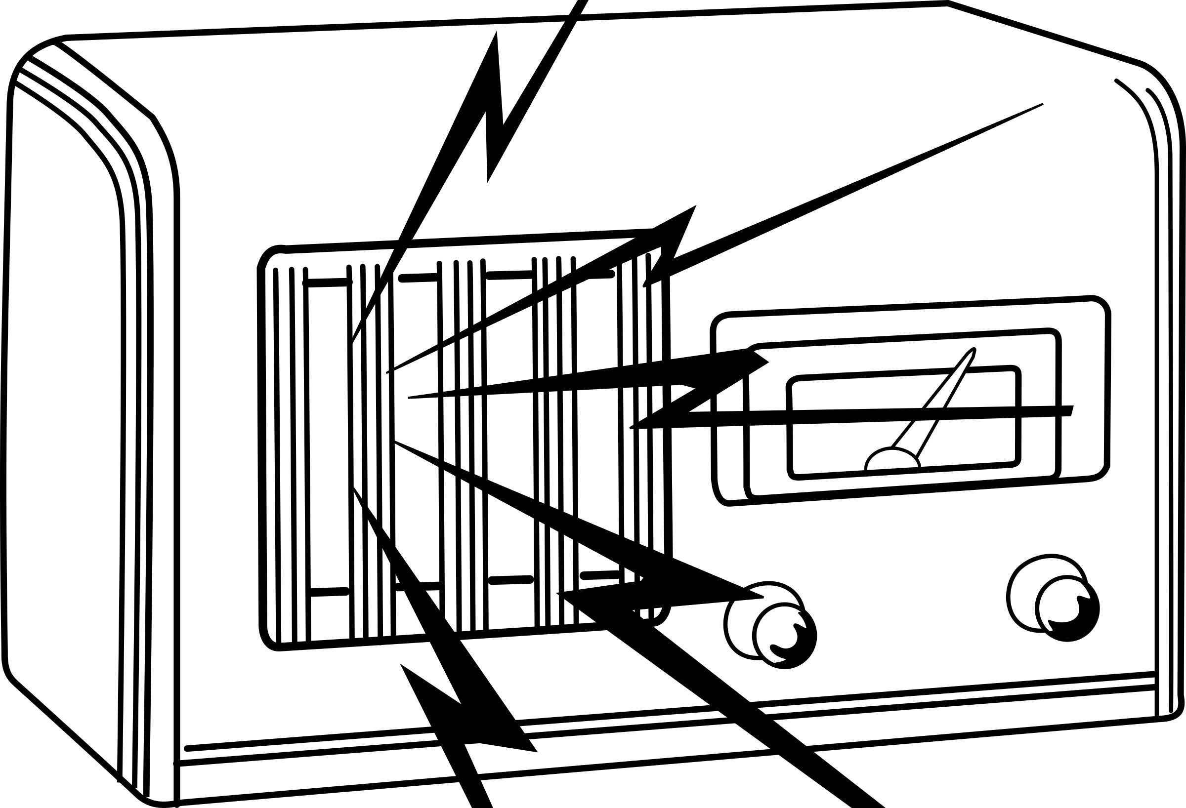
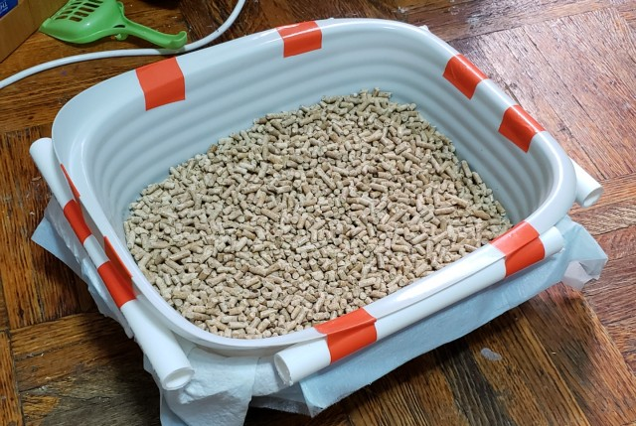
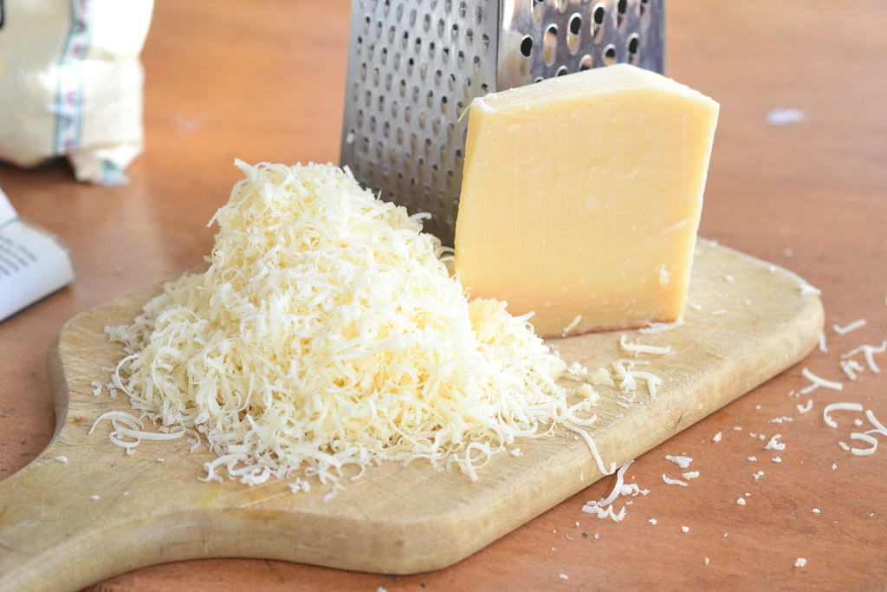
Sensory Overload!
Notes:
To help illustrate how these different senses can cause sensory overload and effect the ability to function in everyday environments, consider the following:
“The radio is on very loud but isn’t tuned in to any station so all you can hear is static and fuzz. The lights are going on and off. You are strapped into a chair that is missing one leg so you are struggling to balance. The table in front of you is sloped and wobbly. You are wearing clothes made of scratchy lace and your underwear is on backwards. Your shoes are too small and squashing your feet. There is a bowl of grated parmesan cheese next to you as well as an open tin of sardines and a tray of cat litter. You are eating your least favourite food that you struggle to swallow because it makes you want to gag. NOW PICK UP A BOOK AND LEARN SOMETHING NEW!”

Slide 7
Routines
In an uncertain world, autistic people find routines reassuring and comforting. When unexpected change occurs this can cause them to be overwhelmed, examples of change include:
A pre-arranged activity being cancelled
Roadworks resulting in a late arrival
A supply teacher at school covering class
Notes:
In an uncertain world, autistic people find routines reassuring and comforting. When unexpected change occurs this can cause them to be overwhelmed, examples of change include, a pre-arranged activity being cancelled, arriving late due to roadworks, or arriving at school to find that a supply teacher is covering class at school.

Slide 8
Repetitive Behaviour
It is common for autistic people to display repetitive behaviour known as ‘stimming’ or self-stimulating behaviour, examples include:
Rocking
Hand-flapping
Spinning
Head-banging
Stimming may be done for:
Enjoyment
To gain sensory input
To reduce sensory input
Notes:
It is common for autistic people to display repetitive behaviour known as ‘stimming’ or self-stimulating behaviour, examples include: Rocking, Hand-flapping, Spinning and Head-banging. Stimming may be done for Enjoyment, To gain sensory input e.g. rocking to stimulate the vestibular (balance) system, or to reduce sensory input e.g. focussing on one particular sound may help to reduce the impact of a loud, overwhelming environment.

Slide 9
Social Communication and Interaction
Autistic people can struggle with social communication and therefore social interactions with others. Difficulties can include:
Recognising non-verbal cues
Interpreting language literally e.g. give me a minute
The ability to ‘put themselves in someone else's shoes and understand that someone may feel differently about a situation.
Notes:
Autistic people can struggle with social communication and therefore social interactions with others. Difficulties can include:
Recognising non-verbal cues e.g. not noticing when someone is becoming bored of a topic and that it is time to change the subject!;
Interpreting language literally e.g. If told “give me a minute”, asking again after exactly one minute, rather than understanding to wait!
And the ability to ‘put themselves in someone elses shoes’ and understand that someone may feel differently about a situation.
It is not uncommon for autistic people to speak in literal factual terms, and say things which although weren’t meant to cause offence, can appear rude.

Slide 10
Living With Autism – a poem by Ava Gallagher (aged 12)
I am very literal and straight to the point
If you want the truth I won't disappoint
When my brain is overloaded I sometimes lash out
My control fades, I scream and shout
I get confused and it all spills out
Intense emotions all trapped inside
Finally have nowhere to hide
Take a seat and sit with me I want to tell you about ASD
Please understand I am not to blame I've just got an atypical brain
But it's not all doom and gloom
I'm often the sportiest girl in the room
I'm quirky, unique, kind and caring
I'm loyal, protective and always sharing
I'm obsessed with frogs and all things green
I'm the youngest trendsetter you've ever seen
Take a seat and sit with me
I am Ava, I am me
I'm not just my label of ASD.”
“Take a seat and sit with me
I want to talk about ASD
If you don't mind I'd like to explain
A little thing called autism and how it affects my brain
It can make me anxious, angry and afraid
But this stays in my head, on my face it's not displayed
I may seem heartless and question your meanings
But it takes me a little longer to process the feelings
Take a seat and sit with me I want to show you ASD
A girl sitting quietly is all you see
But inside my mind I am far from free
My thoughts collide, my senses take over
I become overwhelmed by the smallest sound
Clicking pens, ticking clocks
That boy's chair and the way it rocks
All different smells attacking me
The perfumes, the coffee, the teacher's tea
Take a seat and sit with me
But not too close, I have ASD
I try to be social, I try to fit in
I come across rude, I can never win
Notes:
Finally I’d like to finish with a poem written by Ava Gallagher when she was 12.
Neurodivergent people have to live in a world that is set-up for neurotypical people and this can create lots of challenges. Ava Gallagher won the national “Power of Poetry” competition in 2022 with her entry about living with autism. [read poem from slide].

